Slide 1
Auto scaling group
In AWS, ASG stands for "Auto Scaling Group." An Auto Scaling Group is a service that automatically adjusts the number of instances in a group based on conditions you define. It is designed to help you ensure that your application or service can automatically scale up or down to handle changes in demand while maintaining high availability and optimal performance.
By using Auto Scaling Groups, you can ensure that your application can handle sudden increases in traffic and automatically adjust resources during periods of lower demand, optimizing costs and maintaining a consistent user experience. ASGs are a key component in building resilient and scalable architectures in AWS.

Slide 2
Steps to make a auto scaling group:

Slide 3
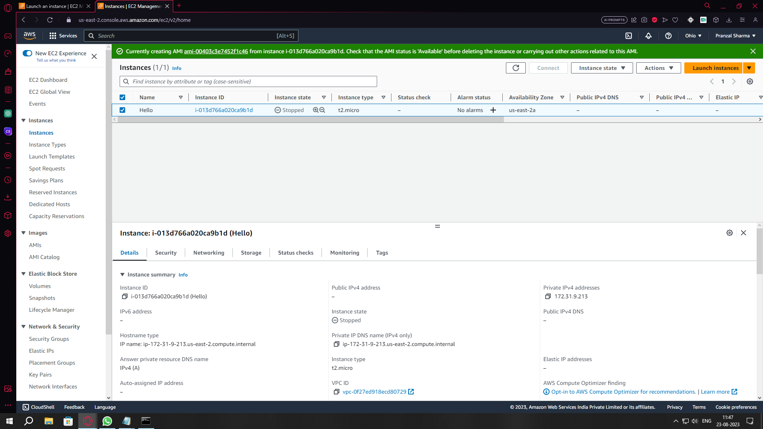
Step 1
Create A instance.

Slide 4
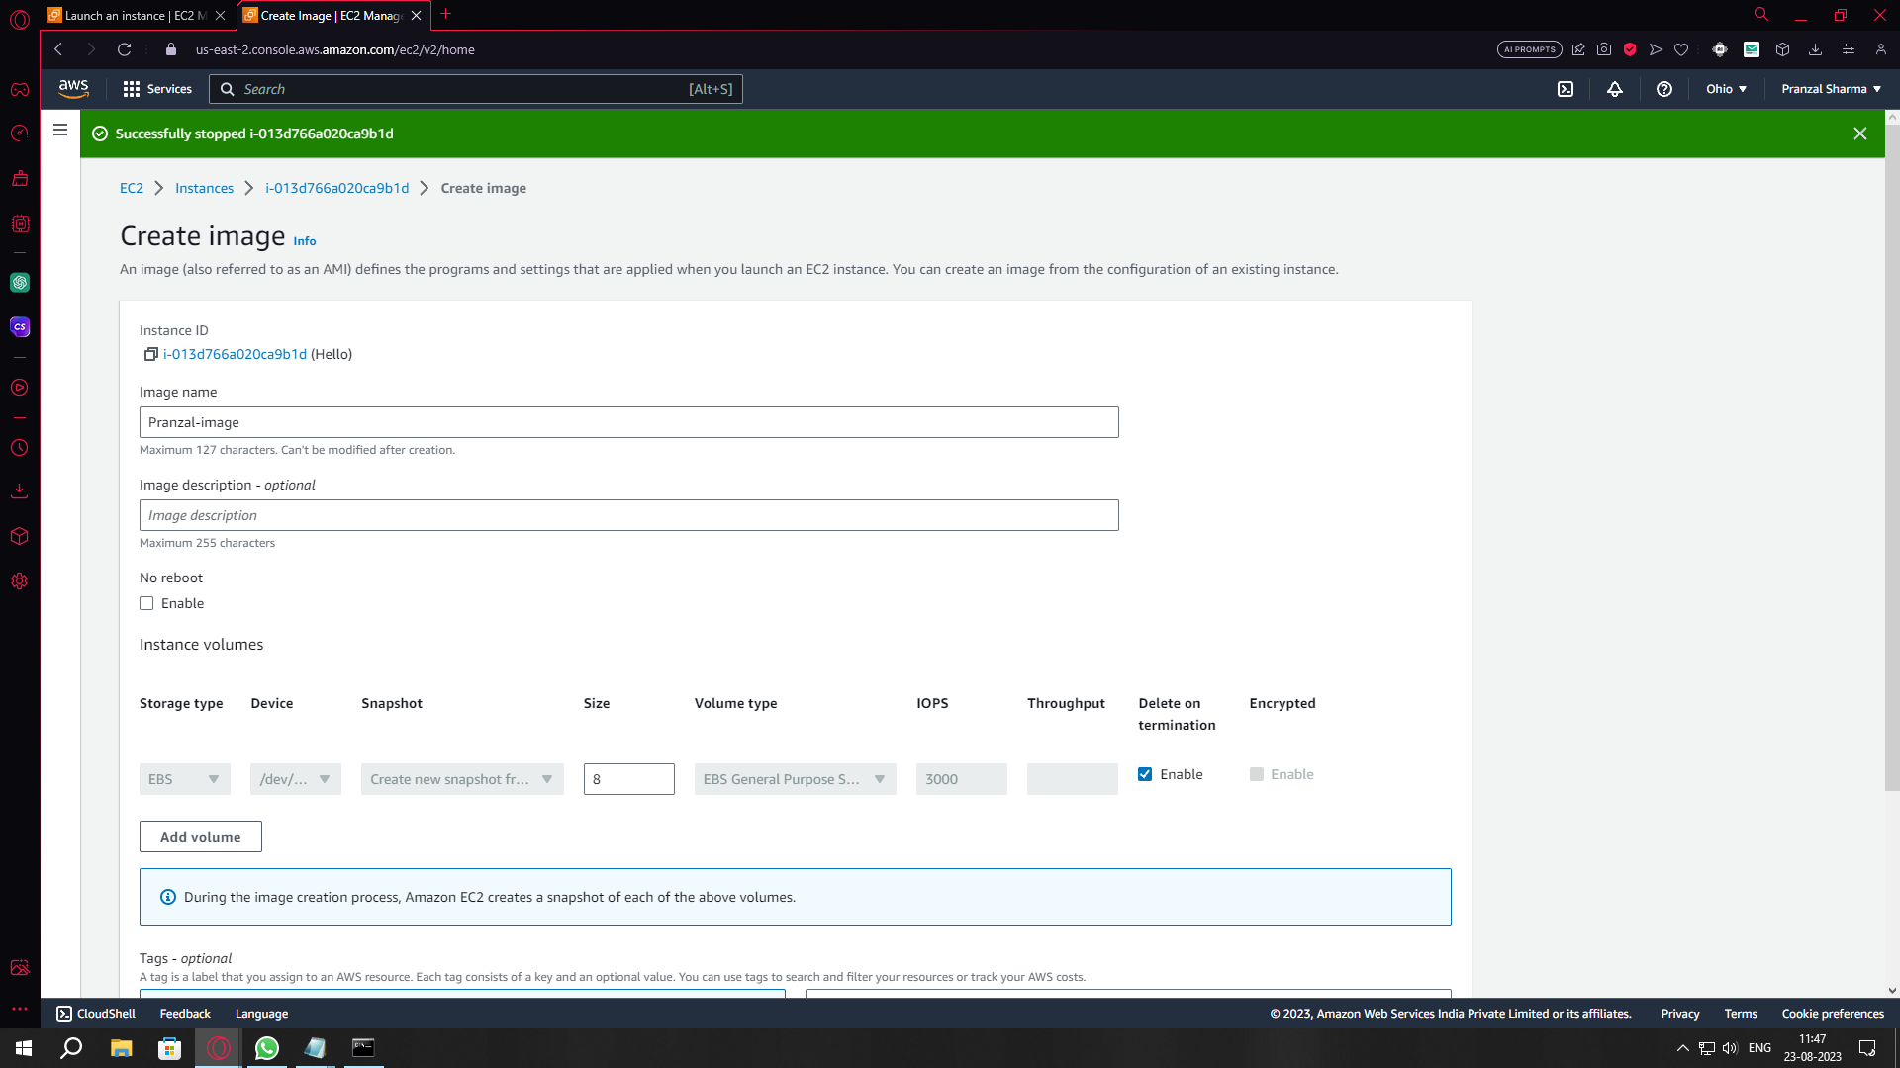
Step 2
Create a Image(AMI) using that instance.

Slide 5
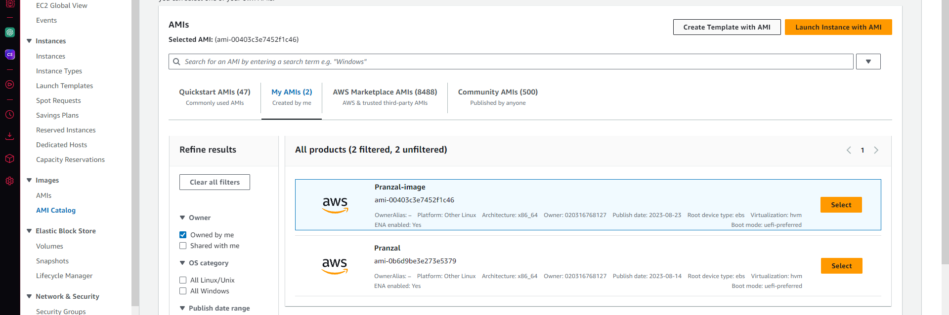
Step 3
After creating AMI, Chose that AMI and create a template.

Slide 6
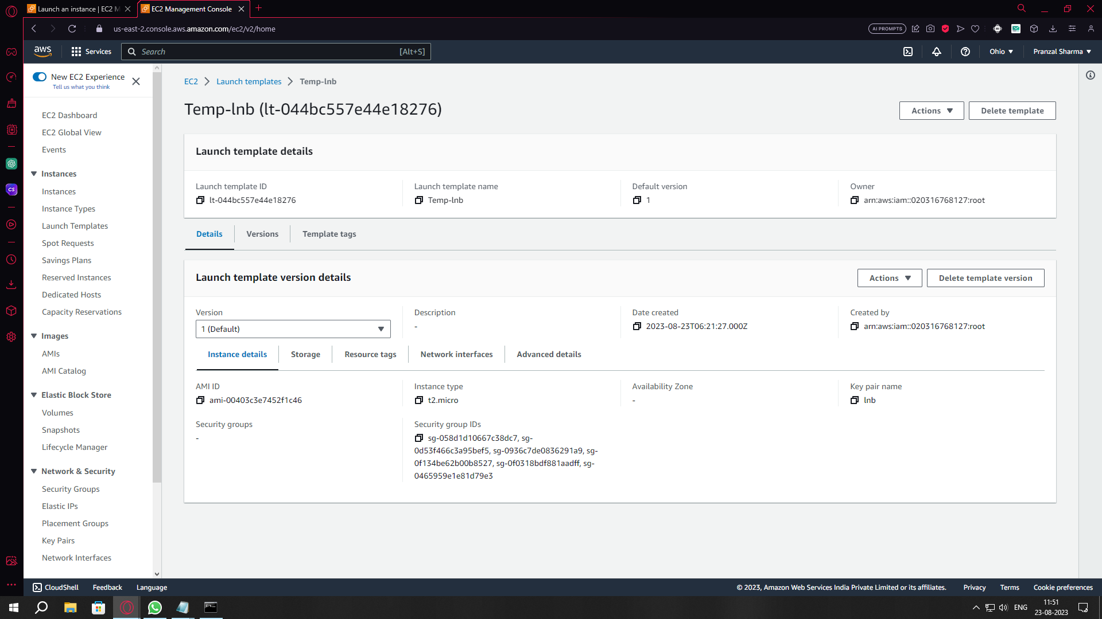

Slide 7
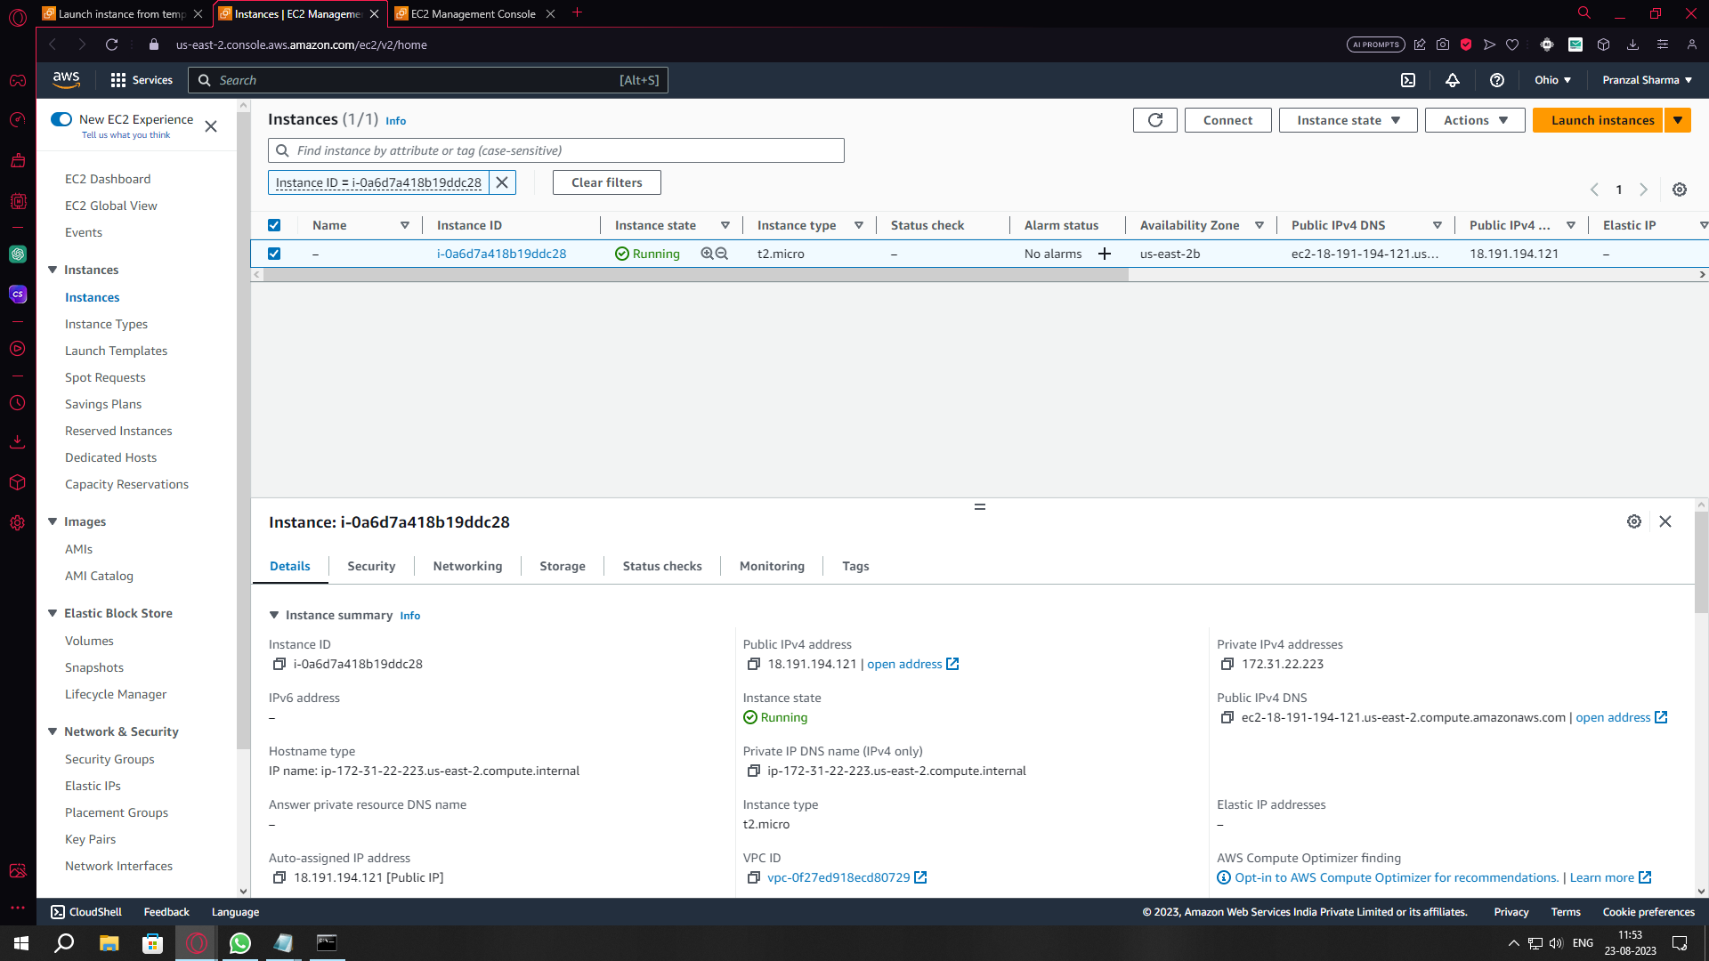
Step 4
Make a instance using that template.

Slide 8
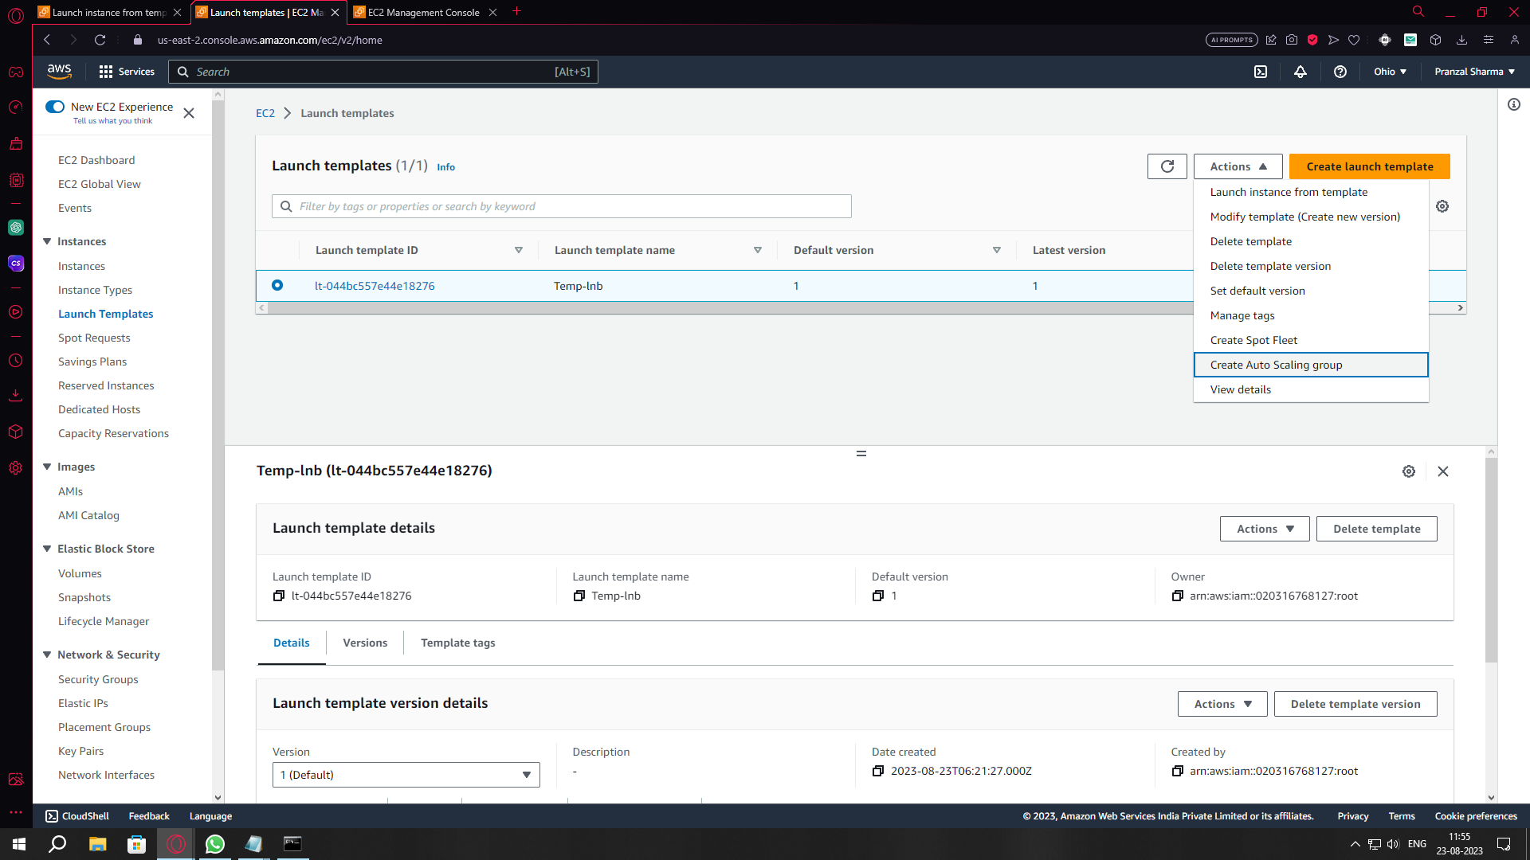
Step 5
Create a auto scaling group by by selecting the template.

Slide 9
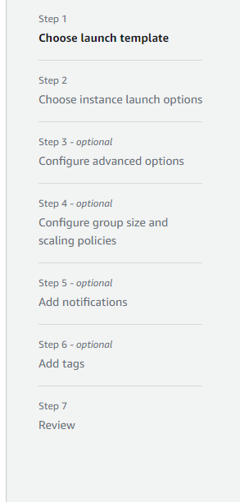
Step 6
Complete all of these steps to launch the auto scaling group.

Slide 10
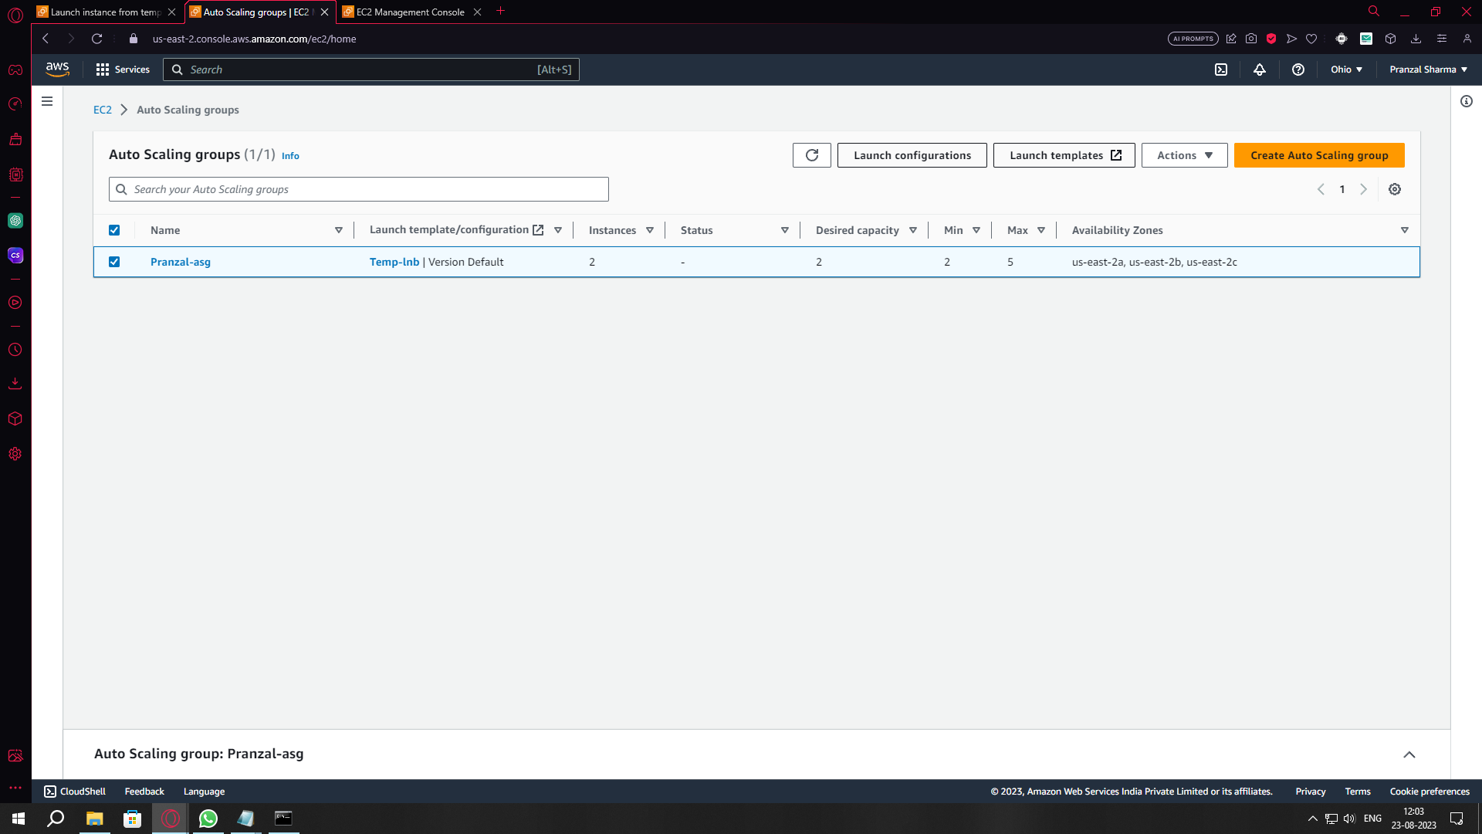
Step 7
Check the newly made Auto scaling group.

Slide 11
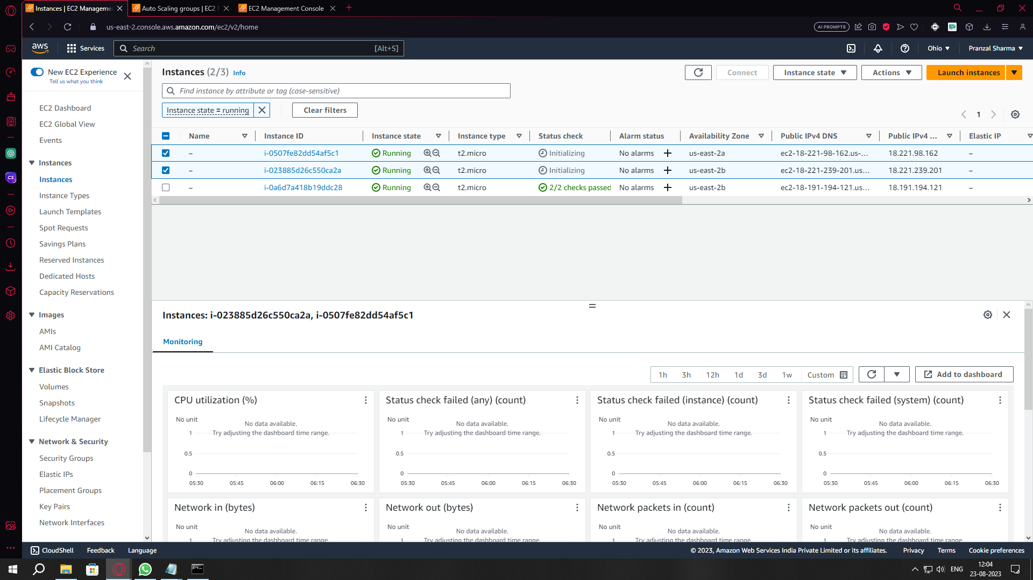
Step 8
Now you can check the new instances that were made by ASG.

Slide 12
THANK you

